Slide 1

Snapdragon 778G: A Deep Dive
This presentation provides an in-depth analysis of the Snapdragon 778G, a mid-range mobile processor designed by Qualcomm. We'll explore its architecture, features, and performance characteristics, demonstrating why it's a compelling choice for various mobile applications. This case study focuses on the selection process and comprehensive analysis that led to choosing this processor.
The Snapdragon 778G is commonly found in smartphones and tablets, offering a balance of performance, efficiency, and advanced features. We'll examine its key benefits, including its processing power, power efficiency, and integrated features like 5G connectivity and AI capabilities.

Slide 2

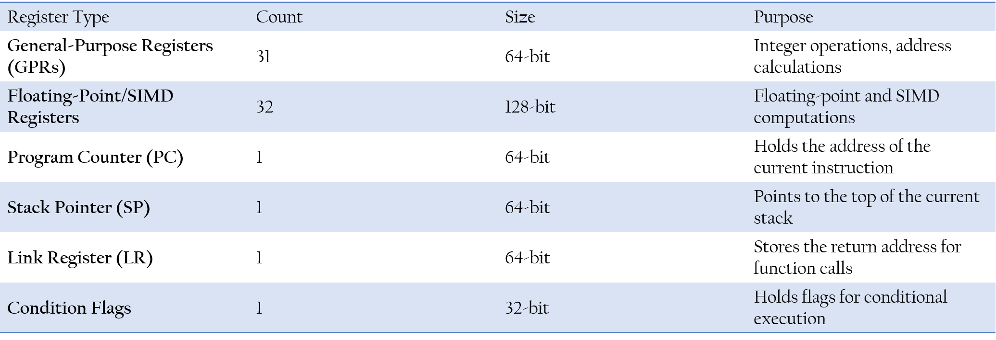
Register Structure:
The Snapdragon 778G utilizes the Kryo 670 CPU, which is based on the ARM Cortex-A78 and Cortex-A55 architecture. Understanding the register structure is crucial for optimizing software and understanding processor behavior.

Slide 3

Instruction Set Architecture (ISA)
The Snapdragon 778G employs the ARMv8.2-A ISA, a widely adopted and versatile architecture known for its power efficiency and performance. The ISA defines the instructions that the processor can execute, dictating how software interacts with the hardware. This includes extensions for SIMD, hardware divide, and cryptography.
Advanced SIMD (Neon)
It utilizes 128-bit SIMD instructions for multimedia and signal processing, accelerating AI tasks.
Hardware Divide
Integer division instructions enable improved performance in mathematical calculations.
Cryptographic Extensions
AES and SHA instructions enhance secure data processing capabilities.
The Snapdragon 778G follows the Modified Harvard Architecture.
Explanation:
Most modern processors, including Qualcomm's Snapdragon series, use a Modified Harvard Architecture, which combines elements of both Von Neumann and Harvard architectures.
The CPU cores (Kryo 670) inside the 778G follow a Harvard-like architecture at the L1 cache level, meaning separate instruction and data caches for better efficiency.
However, at higher memory levels (L2/L3 and RAM), it behaves more like a Von Neumann architecture, where instructions and data share the same memory space.
Conclusion:
The Snapdragon 778G primarily uses a Modified Harvard Architecture for performance and efficiency.

Slide 4

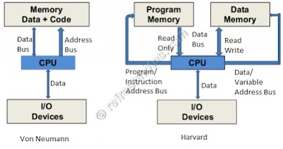

Detailed description of the ISA and the core components involved
Cluster | Core Type | Core Model | Clock Speed
Prime Core | Performance | Kryo 670 Prime (Cortex-A78) | 2.4 GHz
Performance Cores | Performance | Kryo 670 Gold (Cortex-A78) | 2.2 GHz
Efficiency Cores | Power-efficient | Kryo 670 Silver (Cortex-A55) | 1.9 GHz
Category | Details
Architecture | ARMv8.2-A (64-bit)
Instruction Set | AArch64 (64-bit) & AArch32 (32-bit)
Execution Mode | Out-of-Order Execution
Pipeline Stages | 10+ stages (varies per core)
Instruction Width | Fixed 32-bit & variable 16-bit (Thumb)
Registers | 31 General-Purpose Registers (GPRs) + SP, PC
Vector Processing | ARM NEON (SIMD)
Floating Point Unit | IEEE 754-compliant FPU
Branch Prediction | Dynamic Branch Prediction (with Return Stack Buffer)
Memory Model | Weakly Ordered Memory Model
Cache Hierarchy | L1 (Private), L2 (Private), L3 (Shared)
Security Features | TrustZone, Pointer Authentication (PAC), Memory Tagging
Cryptographic Support | AES, SHA-2, RNG (Random Number Generator)
Virtualization | Hardware-Assisted Virtualization (EL2 support)
Atomic Instructions | Load-Acquire (LDAR), Store-Release (STLR)

Slide 5
Datapath Design
The datapath defines how In the Snapdragon 778G, based on the ARM Cortex-A78 and Cortex-A55 cores, the datapath is designed to optimize power efficiency, high-performance execution, and parallel processing.
Key Optimizations in the Datapath :
Superscalar Architecture – Supports multiple instruction dispatch per cycle to maximize performance.
Dynamic Scheduling – Uses out-of-order execution to resolve instruction dependencies dynamically.
Cache Hierarchy – Includes L1, L2, and system-level cache to speed up data retrieval and reduce memory bottlenecks.
Efficient Power Management – Optimizes instruction execution based on workload intensity, ensuring better battery life in mobile devices.
Execution Units :
Each execution unit plays a specific role in processing different types of instructions, ensuring balanced workload distribution across the pipeline.
Execution Unit | Purpose
Integer ALU | Handles integer arithmetic (addition, subtraction, bitwise operations, etc.) and logical operations.
Floating Point Unit (FPU) | Executes floating-point calculations (single and double precision), commonly used in graphics and scientific computations.
Vector Processing Unit (VPU) | Accelerates SIMD (Neon) operations, improving multimedia processing, AI tasks, and DSP workloads.
Load/Store Unit (LSU) | Manages memory accesses, including fetching instructions and handling data transfers between registers and memory.
Branch Unit | Handles branch predictions and speculative execution to minimize pipeline stalls and enhance performance.
Cryptographic Engine | Performs hardware-accelerated encryption and decryption for secure computing (AES, SHA, etc.).
Integer Multiply-Accumulate (IMAC) Unit | Speeds up multiplication and accumulation operations used in AI and DSP tasks.
Prefetch Unit | Anticipates memory accesses to reduce latency and improve execution efficiency.
Out-of-Order Execution Engine | Dynamically reorders instructions to maximize instruction throughput and avoid unnecessary stalls.

Slide 6
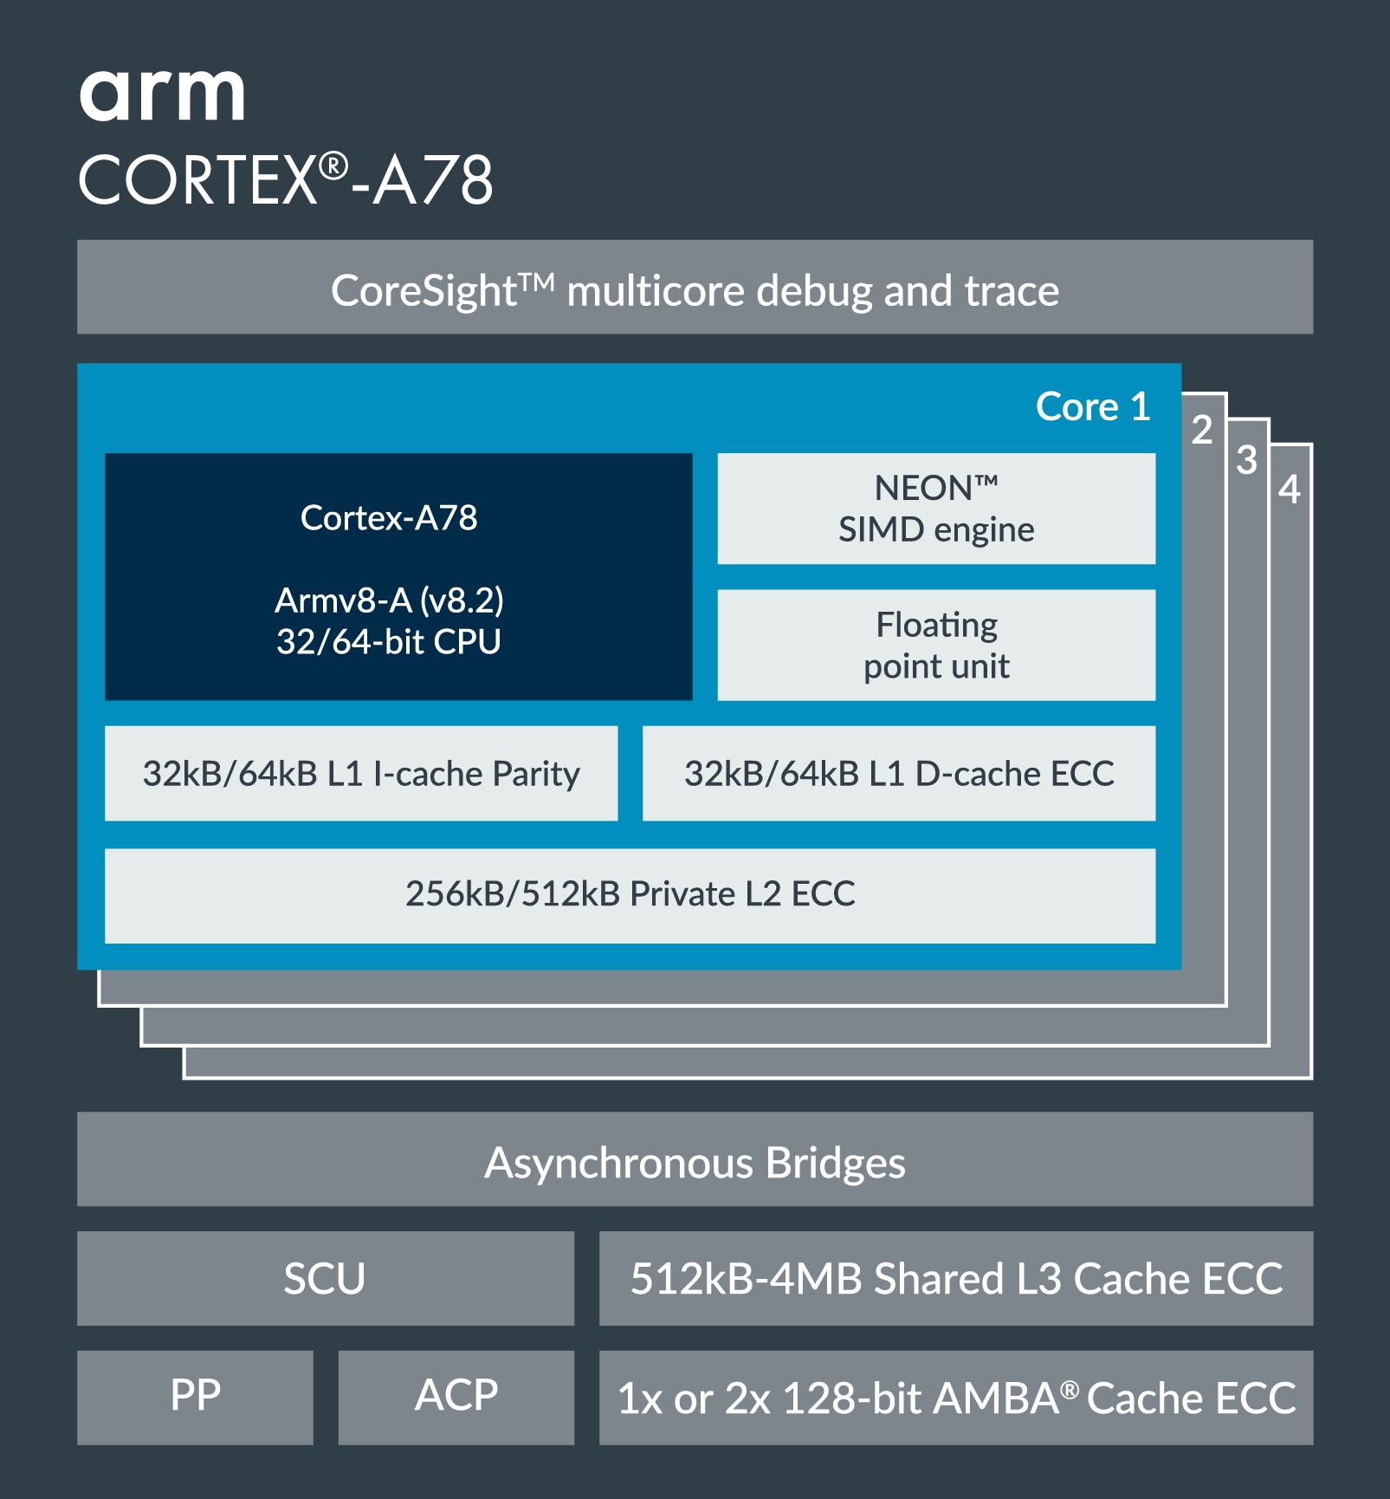
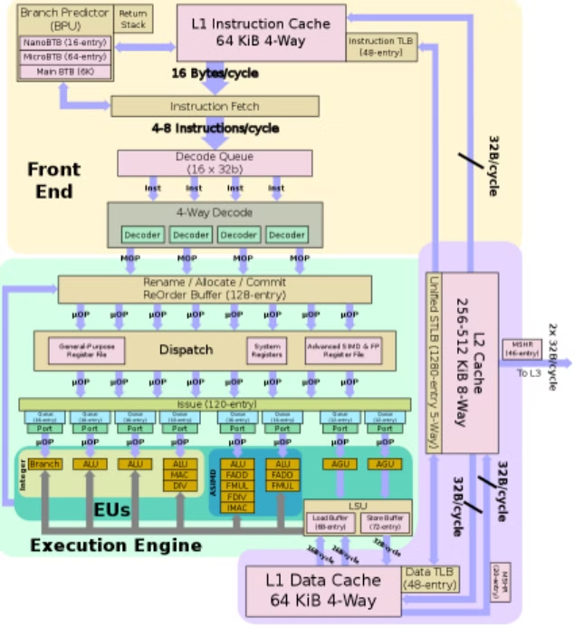
Datapath for CORTEX A78

Slide 7

Pipeline Stages for Cortex –A78
Cortex-A78: 14-Stage Out-of-Order Pipeline
Fetch 1 (F1) – First instruction fetch from L1 cache.
Fetch 2 (F2) – Pre-fetching of instructions continues.
Fetch 3 (F3) – Branch prediction and instruction alignment.
Fetch 4 (F4) – Instruction queueing to smooth execution flow.
Decode 1 (D1) – Instructions start decoding into micro-operations (µops).
Decode 2 (D2) – Further decoding and expansion.
Rename 1 (R1) – Register renaming to remove dependencies.
Rename 2 (R2) – Allocation of µops to execution pipelines.
Dispatch (DIS) – Instructions are dispatched to execution units.
Issue (ISS) – Waiting stage before execution (if needed).
Execute 1 (E1) – First stage of execution (integer, floating-point, or vector).
Execute 2 (E2) – Additional execution cycles for complex instructions.
Writeback (WB) – Results are written back to registers.
Commit (COM) – Instruction is retired successfully.

Slide 8
Datapath and Pipeline Optimization in Snapdragon 778G
Snapdragon 778G is a 5G-ready processor that combines cutting-edge connectivity with powerful AI-driven optimizations. With seamless network speeds, intelligent computing, and enhanced multimedia capabilities, it delivers a next-gen experience for gaming, streaming, and communication.
Feature | Details
📶 Snapdragon X53 5G Modem | Supports Sub-6 GHz and mmWave 5G, reaching up to 3.3 Gbps download speeds. Ensures faster, low-latency mobile data.
📡 Wi-Fi 6E | Operates on the 6 GHz spectrum, offering lower latency, higher speeds, and reduced interference for next-gen wireless networking.
🌍 Multi-Gigabit Connectivity | Supports carrier aggregation, 4G fallback, and seamless network switching, ensuring uninterrupted connectivity.
🛰️ Dual SIM 5G Support | Enables simultaneous 5G connectivity on two SIM cards, perfect for travelers and power users.
🎧 Bluetooth 5.2 | Provides enhanced audio performance, low-power consumption, and improved device pairing for better wireless experiences.
🔄 Ultra-Low Latency | Optimized for real-time applications, including cloud gaming, video conferencing, and remote work.
Feature | Details
🚀 6th Gen Qualcomm AI Engine | Delivers 12 TOPS (Trillions of Operations Per Second) for real-time AI-driven optimizations.
📷 AI-Enhanced Camera | Smart image processing, real-time noise reduction, and low-light photography enhancements using AI-assisted ISP (Image Signal Processor).
🎮 AI-Optimized Gaming | Powered by Snapdragon Elite Gaming™, it enables adaptive refresh rates, real-time HDR enhancements, and lag-free gaming.
🎙️ AI-Powered Voice Assistants | Optimized for Google Assistant, Alexa, and Bixby, offering faster, more natural voice recognition.
🔋 AI-Based Power Management | Uses machine learning to optimize battery life, reducing unnecessary background processes for longer usage.
🖥️ AI-Based Video Processing | AI-driven enhancements improve video streaming clarity, HDR performance, and dynamic contrast adjustments.

Slide 9

Conclusion
The Snapdragon 778G stands out due to its integrated 5G connectivity, advanced AI capabilities, and high-performance camera and graphics. It offers an optimal balance of performance, power efficiency, and cost for a mid-range device, making it a compelling choice in this case study. Selecting the 778G means selecting great quality.
Summary: High-performance mid-range processor with integrated
5G and advanced AI.
Benefits:
Enhanced user experience, optimized for target applications.
Differentiation:
Balance of performance, power efficiency, and cost.

Slide 10
References
Source | Description | Link
Qualcomm Official Product Page | Comprehensive details about the Snapdragon 778G 5G Mobile Platform, including features and specifications. | Qualcomm Snapdragon 778G
Qualcomm Snapdragon 778G Product Brief | An official document outlining the capabilities and technical specifications. | Snapdragon 778G Product Brief (PDF)
NotebookCheck Analysis | Provides benchmark results and an in-depth analysis of the processor's performance. | Snapdragon 778G Benchmarks - NotebookCheck
NanoReview Processor Comparison | Offers a detailed comparison of the Snapdragon 778G with other processors. | Snapdragon 778G Review - NanoReview
CPU Monkey Performance Data | Features benchmark scores and technical specifications. | Snapdragon 778G Specs - CPU Monkey
PhoneDB Datasheet | A comprehensive datasheet with detailed specifications. | Snapdragon 778G Datasheet - PhoneDB
GadgetVersus Performance Comparison | Lists technical specifications and benchmark scores. | Snapdragon 778G vs Others - GadgetVersus
ARM Developer Cortex-A78 Documentation | Detailed ARM Cortex-A78 microarchitecture details, including pipeline stages and ISA. | ARM Developer Cortex-A78
ARM Developer Cortex-A55 Documentation | Detailed ARM Cortex-A55 microarchitecture details, including pipeline stages and ISA. | ARM Developer Cortex-A55

